Slide 1

Smart Waste Management System Using C++
Explore the power of C++ in developing a cutting-edge smart waste management system that optimizes collection routes, monitors waste levels, and reduces environmental impact through innovative sensor integration and data-driven decision making.
KD
by Kumar Dulam

Slide 2
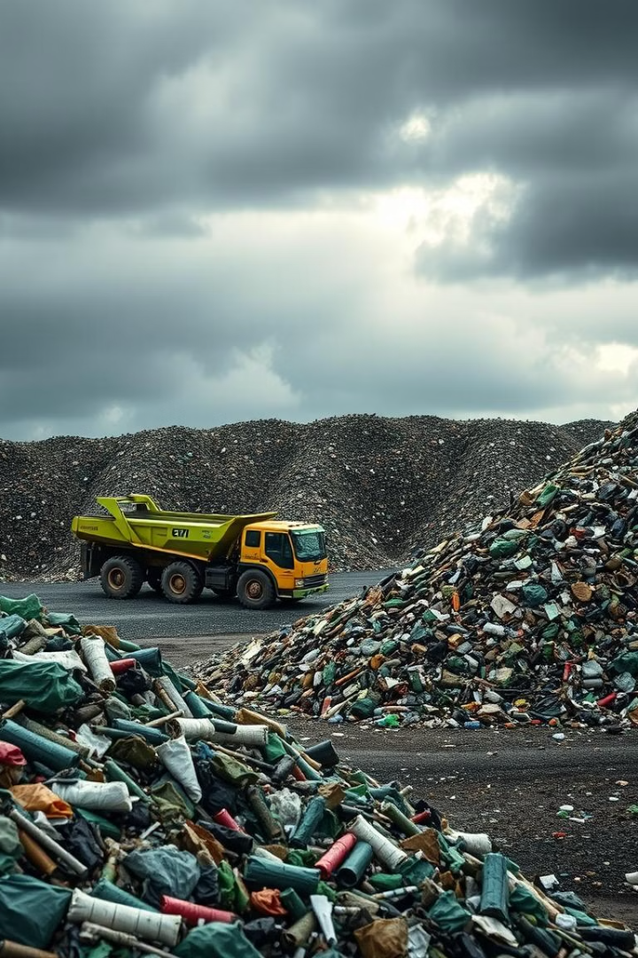
Introduction to Waste Management
1
Growing Waste Crisis
2
Environmental Concerns
Rapidly increasing waste generation strains traditional collection and disposal methods.
Improper waste management leads to pollution, habitat destruction, and greenhouse gas emissions.
3
Public Health Risks
Uncollected waste can attract pests and spread diseases, posing a threat to communities.

Slide 3
Challenges in Traditional Waste Management
Inefficient Collection
Lack of Visibility
High Operational Costs
Limited data on waste levels and collection patterns hinders optimization efforts.
Outdated routes and schedules lead to missed pickups and wasted resources.
Manual processes and inefficient logistics drive up the cost of waste management.

Slide 4
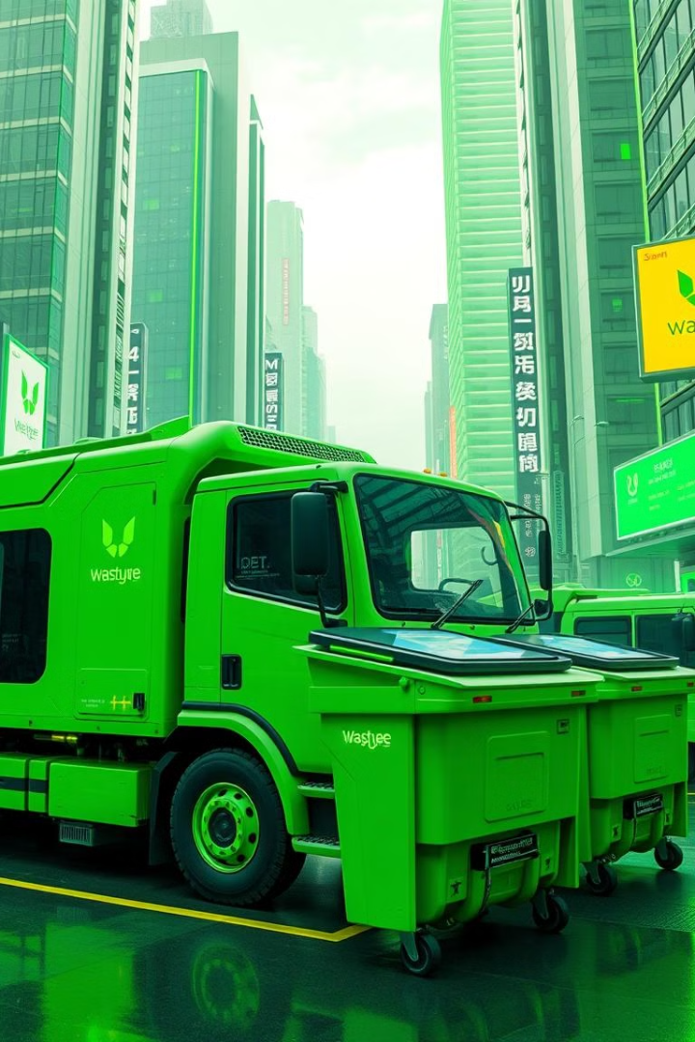
Advantages of a Smart Waste Management System
Optimized Collection
Reduced Costs
Efficient operations, decreased fuel consumption, and automated processes.
Real-time monitoring of waste levels and dynamically adjusting collection routes.
Environmental Benefits
Improved Public Health
Reduced carbon footprint, increased recycling, and better waste diversion.
Timely waste removal, reduced pests and odors, and cleaner neighborhoods.

Slide 5

System Architecture and Components
1
Sensor Integration
Install fill-level sensors in dumpsters to monitor waste accumulation.
2
Data Collection
Gather real-time data on waste levels, collection schedules, and vehicle locations.
3
Cloud-Based Platform
Leverage a scalable cloud infrastructure to process and analyze the collected data.

Slide 6
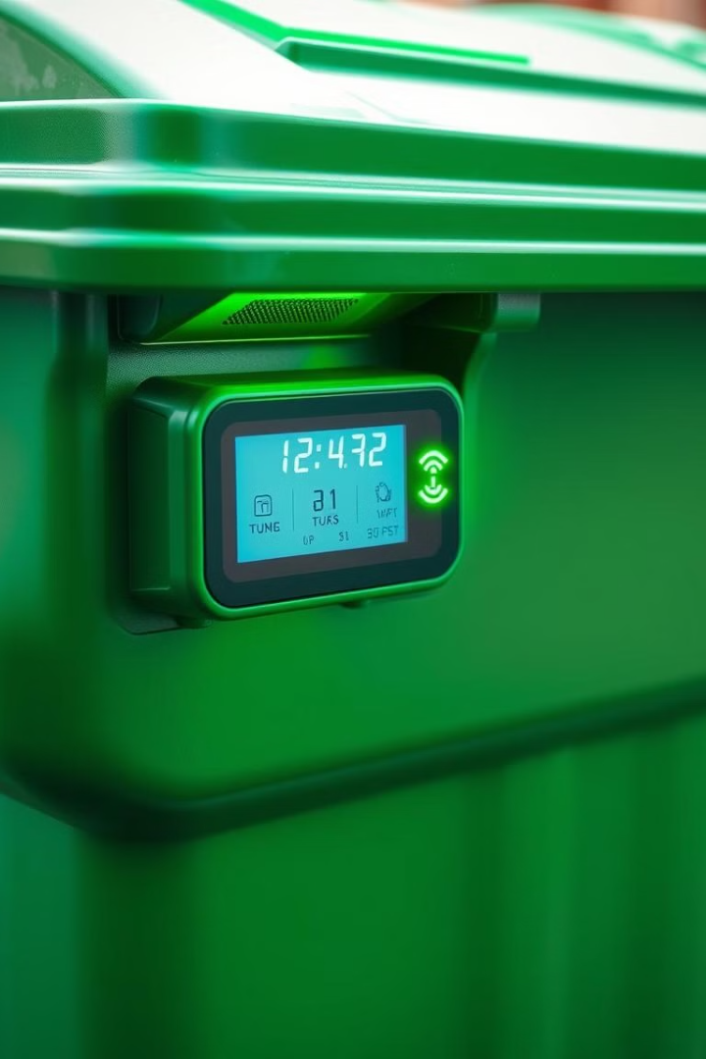



Sensor Integration and Data Collection
Ultrasonic Sensors
Measure the fill level of dumpsters to determine when they need to be emptied.
GPS Tracking
Monitor the real-time location and movements of waste collection vehicles.
Wireless Connectivity
Transmit sensor data to the central cloud platform for processing and analysis.

Slide 7
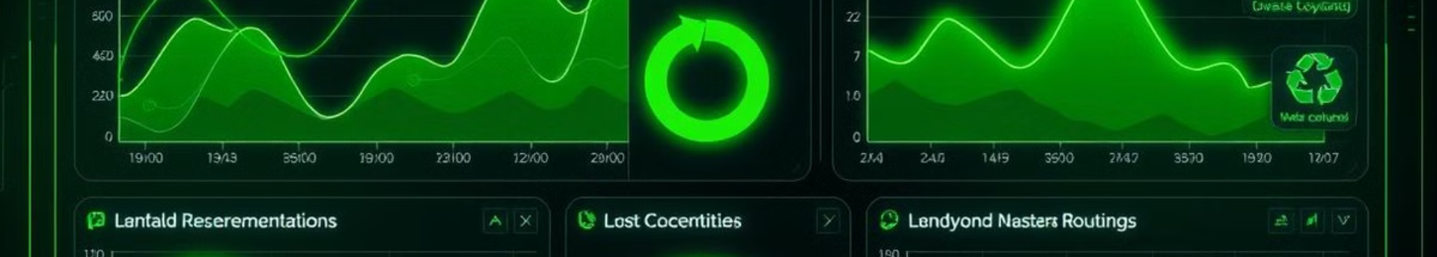



Data Analysis and Optimization
Data Collection
Analytics
Insights
Gather real-time data from sensors and tracking devices.
Apply advanced algorithms to optimize collection routes and schedules.
Generate data-driven recommendations to enhance operational efficiency.

Slide 8
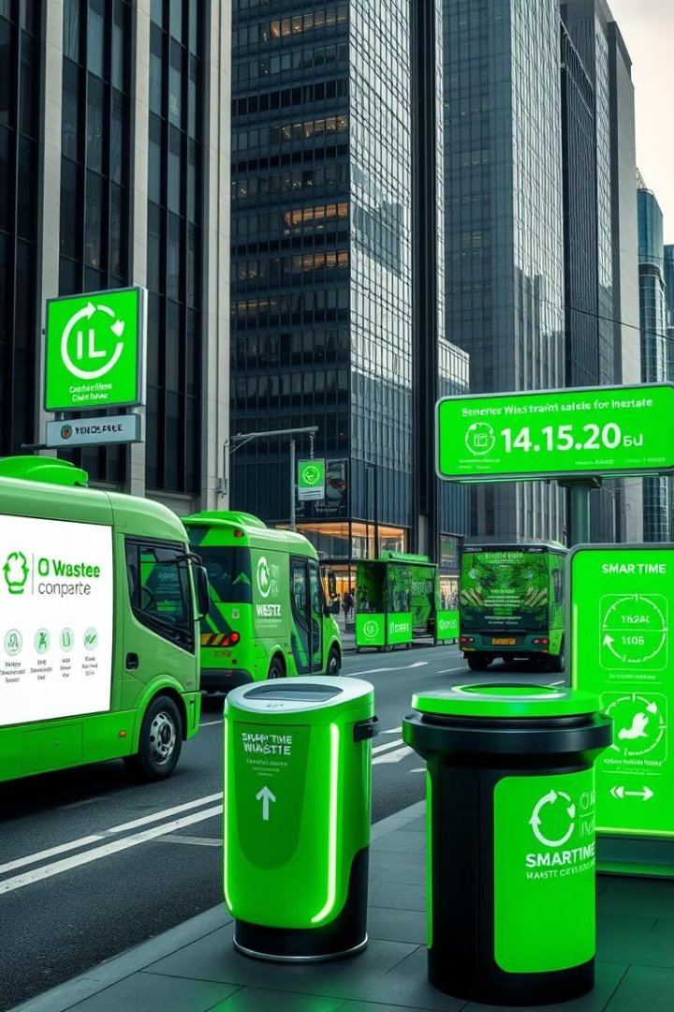
Real-World Implementation and Case Studies
City
Waste Reduction
Cost Savings
Barcelona, Spain
25%
$1.6 million/year
Seoul, South Korea
15%
$3.2 million/year
New York City, USA
20%
$2.4 million/year

Slide 9

Conclusion and Future Prospects
As cities strive to become more sustainable, smart waste management systems powered by C++ offer a transformative solution. By leveraging data-driven insights and innovative technologies, we can reduce waste, cut costs, and create a cleaner, healthier environment for all.

